Slide 1
BeyondTranscripts
Recommendations for student performance and retention
Notes:
Introduction is classroom style

Slide 2







Slide 3

PROBLEM
Universities:
~$8 million in tuition
Ranking
Federal and state funding
Alumni donations
Retention budget
Students:
$32,000 in salary
Worthless student debt
Instructors:
Instruction quality
Course satisfaction
Academic Disqualification
16.6 million students enrolled (2019)
40%
drop out
28%
Is there a solution to help everyone?
Notes:
16.6 million students (2019), 40% drop out, 28% of that due to academic disqualification, average tuition is $22,698 → $42.2 billion, 5300 colleges/universities → $7,962,287.09 lost per university per year on tuition (and universities spend on student retention)

Slide 4
SOLUTION
A web-based platform that provides personalized recommendations to instructors and students by analyzing fine-grained student data.
Universities CAN: Students GET:
Instructors CAN:
Retain students
Personalized recommendations
Be more informed
Address student issues promptly
Efficiently adapt for future iterations of the course
Notes:
NOVELTY and INSIGHT:
use existing course materials and assessments to understand a student’s performance
use machine learning to take historical data and alert instructors to students who may be falling through the cracks, or predict concepts that the class will likely have difficulty with
Allows an instructor to respond to specific student issues more quickly
Allows an instructor to tailor course materials for the class as the semester continues
Saves instructor time in diagnosing class or student issues.
“Premium version” → provide recommendations for content to include
Universities retain students at lower cost

Slide 5
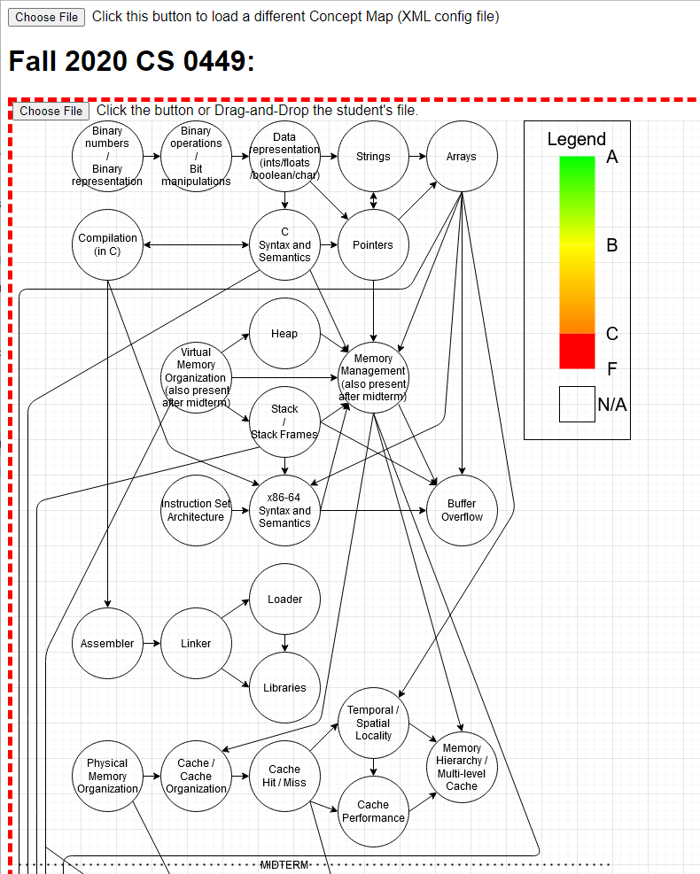
PRODUCT - Map Generation
Assignments
BeyondTranscripts
Instructor
Syllabus
Lectures
Notes:
Emphasize this is real data from the class

Slide 6
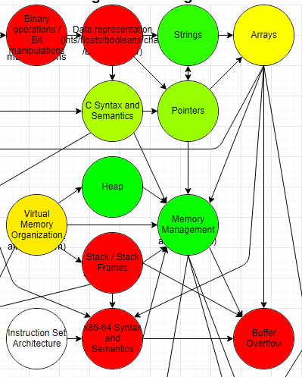

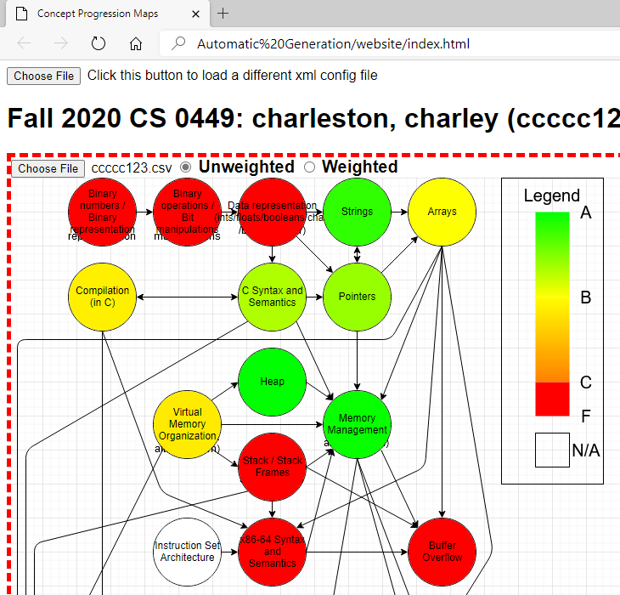
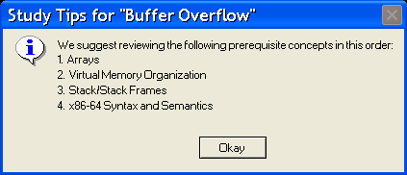
PRODUCT - Student View
Notes:
Student view
Prediction that the student will not do well in Buffer Overflows in the exam
How do we help those that flunks? Dive deeper into the recommendations --> show links to educational content

Slide 7
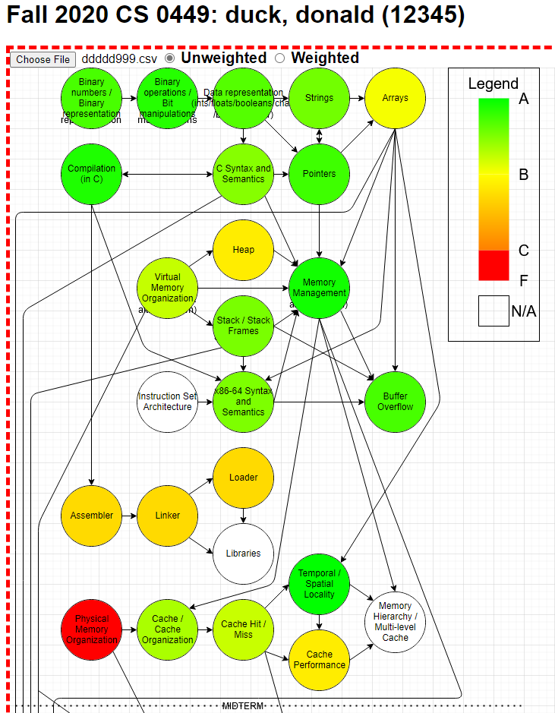
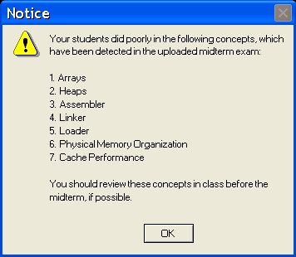
PRODUCT - Instructor View (I)

Slide 8
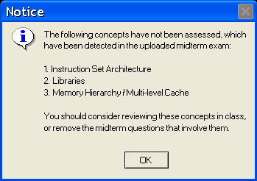
PRODUCT - Instructor View (II)
Notes:
The midterm contains concepts that have not been assessed before. You should consider reviewing them before the exam or removing questions that involve them.

Slide 9
MARKET VALIDATION
Analysis does not necessarily help to retain students
25% of universities represents $500M market size
1,400 use predictive analytics
99% of 5,300 USA universities utilize Learning Management Systems to collect student data
3,900 do not use predictive analytics
Cannot identify at-risk students automatically
Notes:
Estimates of colleges and universities running LMS are almost always near 99% - https://er.educause.edu/articles/2015/6/whats-next-for-the-lms
5300 colleges and universities in america - https://www.educationunlimited.com/blog/how-many-universities-colleges-are-in-the-us/
An estimated 1,400 institutions nationwide use predictive analytics -
https://www.educationnext.org/big-data-on-campus-putting-predictive-analytics-to-the-test/#:~:text=An%20estimated%201%2C400%20institutions%20nationwide,may%20benefit%20from%20additional%20support.
Need to demonstrate to a university that students have better outcomes from the service (an outcome that is important to the university)
Cost-reduction? Simplification? Time and money saved on academic advisor role?
What stakeholder wins big on this in terms of economic impact?
Estimates of colleges and universities running LMS are almost always near 99% - https://er.educause.edu/articles/2015/6/whats-next-for-the-lms
5300 colleges and universities in america - https://www.educationunlimited.com/blog/how-many-universities-colleges-are-in-the-us/
16.6 million students in undergraduate enrollment 2019 - https://nces.ed.gov/programs/coe/indicator/cha
1.5 million faculty in colleges 2018 - https://nces.ed.gov/fastfacts/display.asp?id=61
40% drop out per year, 30% drop out freshman year https://educationdata.org/college-dropout-rates
28% of that is due to academic disqualification.
22,698 yearly average out of state tuition https://www.usnews.com/education/best-colleges/paying-for-college/articles/paying-for-college-infographic
16.6 million * 0.4 * 0.28 * 22698 = 42200121600 ~ $42.2 billion dollars left out per year
College grads earn $32,000 more per year than those with only a high school diploma. https://www.aplu.org/projects-and-initiatives/college-costs-tuition-and-financial-aid/publicuvalues/employment-earnings.html
Alumni are the second largest group to donate to higher educational institutions, $12.15 billion in 2018, behind foundations https://www.case.org/resources/voluntary-support-education-trends-alumni-giving
https://nces.ed.gov/fastfacts/display.asp?id=75 ~$401 billion spent at public institutions, 21% of that is spent on academic support, student services, and institutional support → ~88 billion spent here.
https://www.pilbaragroup.com/its-a-no-brainer-increasing-student-retention-makes-highered-more-money-or-does-it/
ED536126.pdf “A key finding is that although 35 percent of students left without finishing, these students accounted for 19 percent of total instructional and related spending” (p 5)
What is adoption of predictive analytics in the past 10 years?
1400 * 0.25 * 300,000 spent on student retention on average
Predictive analytics are boosting college graduation rates, but do they also invade privacy and reinforce racial inequities? (hechingerreport.org) - 300k on average for analytics, 500M market (2019)

Slide 10
0
products analyze student performance in course content

Slide 11


















Significant
Recommendation Level
4-BOX
BeyondTranscripts
Data Granularity
Coarse
Fine
None
Notes:
Red - targeted enrollment marketing for incoming students
Orange - Academic advising
Green - Academic Administration
Dark blue - Direct to student software
Purple - Learning Management System
Light blue - course content and student performance analysis
—-----
PeopleSoft-
General purpose organization for large companies with lots of people
For Pitt, they use it generally for enrollment, scheduling, and official grade-keeping
OTHOT-Probability-based business metrics of success (i.e. enrollment, likelihood to pass, likelihood of retention, etc.) only for advisors, but given administrative metrics
Business oriented metrics for educational institutions (along with editing software to distribute insights to others) only for administrators
The success of BeyondTranscripts will provide a basis for an augmentable startup that supplies educational institutions with an all-inclusive service for analyzing their existing student data—(not collecting more data).
None of them are course-content oriented

Slide 12
BUSINESS MODEL
$8M
potential market per university
$200,000 license fee
$500M
per year
Yearly cost per university, 2.5% of their potential earnings (only 9 of 351 students to break even!)
Yearly tuition loss per university from students dropping out
Based on current market of predictive analytics
Notes:
$42.2 billion dollars lost in tuition per year lost by all universities due to students dropping out
$7,962,287.09 lost per university (5300 colleges/universities)
https://hechingerreport.org/predictive-analytics-boosting-college-graduation-rates-also-invade-privacy-and-reinforce-racial-inequities/ (colleges spend 300k on predictive analytics, we cost less)
Briefly mention non-financial gains (i.e. due to higher retention → higher ranking)

Slide 13
DEVELOPMENT AND SUPPORT COST
Development: Build in-house for 6 months
Support: $15,000 overhead for deployment at Pitt

Slide 14


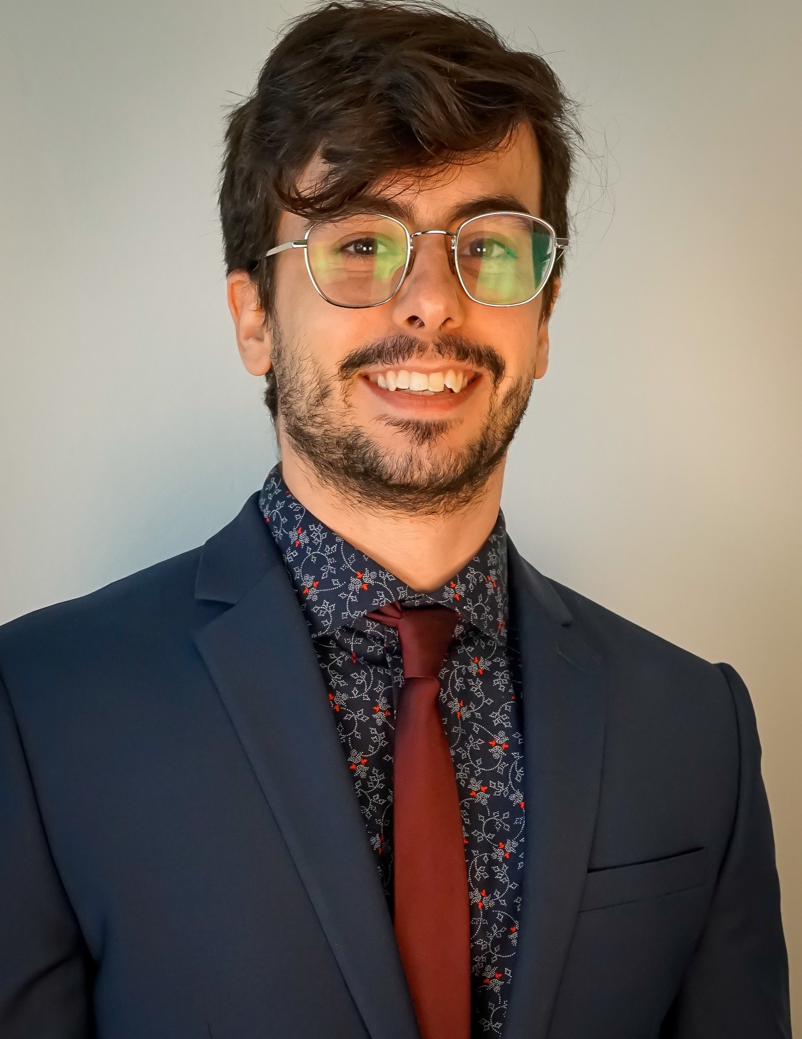



Co-Founder and CEO: Nathan Ong
Senior Software Developer: Jacob Hoffman
Senior Software Developer: Jonathan Hanobik
Software Developer: Fangzheng Guo
Software Developer: Jiaye Zhu
Co-Founder and Advisor: Dr. Daniel Mosse
Support: 12 undergraduates 4 academic advisors 1 NACADA member
Looking for Team Members in: Sales/Marketing
Notes:
Why are we the right people for the job?
Nathan, Jacob, Dr. Mosse + accolades, Jonathan, academic advisors, NACADA, post-doc, previous grad students (Fangzheng and Jiaye), IS graduate and undergraduate capstone students
Advisor moves to the bottom
Looking for sales
(just put pictures and title)

Slide 15
NEXT STEPS
CRITICAL MASS
College-prep high schools
Features for other educational stakeholders
Release commercial product
Premium feature development
Institution Expansion
Complete MVP
Partnerships with educational content companies
0.5 years
1.5 years
2 years
3 years
4 years
Content Expansion
Proof-of- concept at Pitt (select departments)
Already landed with Pitt Provost’s Office
Finalizing agreement with Kansas State University
White paper
Deployment at Pitt and KSU (all departments)
5 universities (50k students, 750 teachers)
15 universities (150k students, 2,250 teachers)
International Expansion
International Universities
Notes:
How many universities/high schools/educational institution? How many faculty members overall?
Expansion to work environments’ educational systems/work training programs
Numbers, $X per student per year → total revenue
When considering the number of students (university and beyond) and the diversity of majors and courses, it is clear that the potential expansion of this service is immense.
How big of an impact can you make (size of potential market)? What segment of the market is your idea? Who are your customers? Why will they pay for your soltn?
106,000 undergraduate CS students accepted every year https://www.nytimes.com/2019/01/24/technology/computer-science-courses-college.html
Assume $100 per student per year, for that cohort that graduates successfully, that would be $10,600,000 a year
But it can apply to other STEM majors, other educational stakeholders like students, instructors, academic advisors, administrators, high schools, parents, work training programs, graduate schools
Show milestones

Slide 16
Transcripts no longer suffice;
it’s time to go BeyondTranscripts

Slide 17
EXTRA SLIDES

Slide 18
PROBLEM
16.6 million students (2019), 40% drop out, 28% of that due to academic disqualification, average tuition is $22,698 → $42.2 billion, 5300 colleges/universities → $7,962,287.09 lost per university per year on tuition (conservative, what if they are freshmen? Then the university potentially loses more on that student) (and universities spend on student retention)
No standard analytic tool to track student progression as they complete the major (aside from transcripts)
Focus on prestige/rank, and the costs associated with that
Maybe focus on Time To Degree instead,
We first focus on (low-hanging fruit): Better advising? Better instructor adaptability? (which then leads to better things)
Articulate possible ideal outcomes, and contrast that with where we are now, then how do we get there
Notes:
5 million undergraduate students drop out every year. As a teaching assistant and teaching fellow, it
How much does university spend on student retention? (maybe not something we can answer?)
Need to demonstrate to a university that students have better outcomes from the service (an outcome that is important to the university)
Cost-reduction? Simplification? Time and money saved on academic advisor role?
What stakeholder wins big on this in terms of economic impact?
Estimates of colleges and universities running LMS are almost always near 99% - https://er.educause.edu/articles/2015/6/whats-next-for-the-lms
5300 colleges and universities in america - https://www.educationunlimited.com/blog/how-many-universities-colleges-are-in-the-us/
16.6 million students in undergraduate enrollment 2019 - https://nces.ed.gov/programs/coe/indicator/cha
1.5 million faculty in colleges 2018 - https://nces.ed.gov/fastfacts/display.asp?id=61
40% drop out per year, 30% drop out freshman year https://educationdata.org/college-dropout-rates
28% of that is due to academic disqualification.
22,698 yearly average out of state tuition https://www.usnews.com/education/best-colleges/paying-for-college/articles/paying-for-college-infographic
16.6 million * 0.4 * 0.28 * 22698 = 42200121600 ~ $42.2 billion dollars left out per year
College grads earn $32,000 more per year than those with only a high school diploma. https://www.aplu.org/projects-and-initiatives/college-costs-tuition-and-financial-aid/publicuvalues/employment-earnings.html
Alumni are the second largest group to donate to higher educational institutions, $12.15 billion in 2018, behind foundations https://www.case.org/resources/voluntary-support-education-trends-alumni-giving
Student Retention, Poor advising, Advisors being expected to understand entire major curriculum (not feasible), Student struggles in class
Universities losing money because of student drop out
Universities not using student data effectively
Instructors have too many students to care about the individual
Administrators are changing the curriculum without data-driven evidence
—-

Slide 19
PROBLEM
Financial: 16.6 million students per year pay $40B of tuition
BUT 40% drop out… $8B lost per year
Human: 40% drop out, 28% of that due to academic disqualification
Until today: no standard analytic tool to track student progression
Notes:
5 million undergraduate students drop out every year. As a teaching assistant and teaching fellow, it
How much does university spend on student retention? (maybe not something we can answer?)
Need to demonstrate to a university that students have better outcomes from the service (an outcome that is important to the university)
Cost-reduction? Simplification? Time and money saved on academic advisor role?
What stakeholder wins big on this in terms of economic impact?
Estimates of colleges and universities running LMS are almost always near 99% - https://er.educause.edu/articles/2015/6/whats-next-for-the-lms
5300 colleges and universities in america - https://www.educationunlimited.com/blog/how-many-universities-colleges-are-in-the-us/
16.6 million students in undergraduate enrollment 2019 - https://nces.ed.gov/programs/coe/indicator/cha
1.5 million faculty in colleges 2018 - https://nces.ed.gov/fastfacts/display.asp?id=61
40% drop out per year, 30% drop out freshman year https://educationdata.org/college-dropout-rates
28% of that is due to academic disqualification.
22,698 yearly average out of state tuition https://www.usnews.com/education/best-colleges/paying-for-college/articles/paying-for-college-infographic
16.6 million * 0.4 * 0.28 * 22698 = 42200121600 ~ $42.2 billion dollars left out per year
College grads earn $32,000 more per year than those with only a high school diploma. https://www.aplu.org/projects-and-initiatives/college-costs-tuition-and-financial-aid/publicuvalues/employment-earnings.html
Alumni are the second largest group to donate to higher educational institutions, $12.15 billion in 2018, behind foundations https://www.case.org/resources/voluntary-support-education-trends-alumni-giving
Student Retention, Poor advising, Advisors being expected to understand entire major curriculum (not feasible), Student struggles in class
Universities losing money because of student drop out
Universities not using student data effectively
Instructors have too many students to care about the individual
Administrators are changing the curriculum without data-driven evidence
—-

Slide 20
PROBLEM
Student Retention: 16.6 million students (2019), 40% drop out, 28% of that (total ~11%) due to academic disqualification every year, 1.9 million students total
Universities lose out: tuition, ranking, federal funding, alumni donations, and spending extra on student retention
Students lose out: Dropping out means wasted tuition/student debt, and lose out on 32,000 extra salary
No automatic recommendation tool that analyzes course content information, instructors cannot gauge how prepared students are for upcoming assessments, especially if they teach many classes or teach large classes
Notes:
16.6 million students (2019), 40% drop out, 28% of that due to academic disqualification, average tuition is $22,698 → $42.2 billion, 5300 colleges/universities → $7,962,287.09 lost per university per year on tuition (and universities spend on student retention)
40% drop out per year, 30% drop out freshman year https://educationdata.org/college-dropout-rates
28% of that is due to academic disqualification.
22,698 yearly average out of state tuition https://www.usnews.com/education/best-colleges/paying-for-college/articles/paying-for-college-infographic
16.6 million * 0.4 * 0.28 * 22698 = 42200121600 ~ $42.2 billion dollars left out per year
5300 colleges and universities in america - https://www.educationunlimited.com/blog/how-many-universities-colleges-are-in-the-us/
16.6 million students in undergraduate enrollment 2019 - https://nces.ed.gov/programs/coe/indicator/cha
College grads earn $32,000 more per year than those with only a high school diploma. https://www.aplu.org/projects-and-initiatives/college-costs-tuition-and-financial-aid/publicuvalues/employment-earnings.html
Non-graduates do not donate (as they are not alumni)

Slide 21
PROBLEM
Student Retention:
Out of 16.6 million students, 40% dropped out (2019)
28% drop out every year due to academic disqualification (1.9 million students)
Each university in the USA misses out on $8 million per year from student drop out
Universities LOSE:
Tuition Revenue | Ranking | Federal Funding | Alumni Donations
Wasted Retention Costs
Students LOSE:
Worthless Student Debt | Average Salary Increase
How can instructors be empowered to save at-risk students?

Slide 22
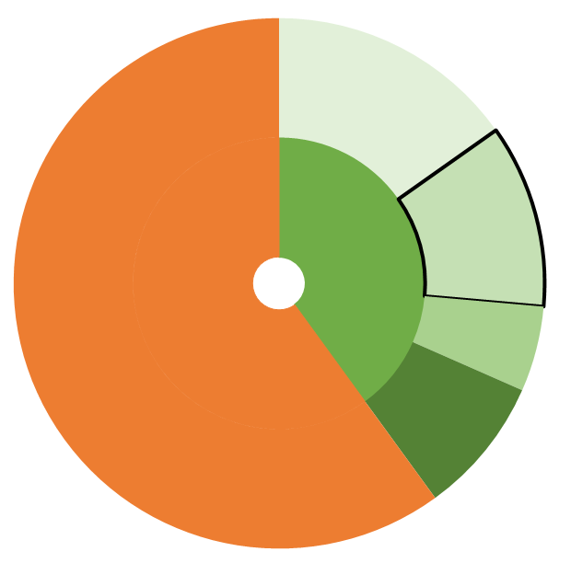
PROBLEM
Financial
Universities:
~$8 million in tuition
Ranking
Federal and state funding
Alumni donations
Retention budget
Students:
$32,000 in salary
Worthless student debt
Instructors:
Instruction quality
Course satisfaction
~15%
Academic Disqualification
16.6 million students enrolled (2019)
40%
drop out
~11%
~5%
Social
~8%
Other
How can instructors be empowered to save at-risk students?

Slide 23
SOLUTION
A web-service that analyzes fine-grained student data to provide easy-to-understand and relevant analyses to all educational stakeholders
Stakeholders: students, instructors, academic advisors, and administrators
NOVELTY and INSIGHT:
use existing fine-grained data within the course automatically
use machine learning to take historical data and make predictions (what are these)
What is the outcome change from the solution? What is meaningful? What do the interventions do? Tie it to timing (can administer intervention faster)
Wireframe of landing page/logo/primer of the solution
Notes:
Pain Point -
Student - I struggled with XYZ course, and I sought help from my TAs and instructors on many occasions. However, my TA was not an expert in the class, the instructor was too busy helping the rest of the 300 students, my academic advisor doesn’t understand the course content, and the administration only directed me to outside tutoring resources. I was on the verge of giving up.
The significant amount of performance data already being collected about students by universities is seldom utilized to enhance the university experience. This lack of data usage is a waste of potential for all educational stakeholders, but most importantly, it affects every students’ maximum potential to be educated.
What problems are we trying to solve?

Slide 24
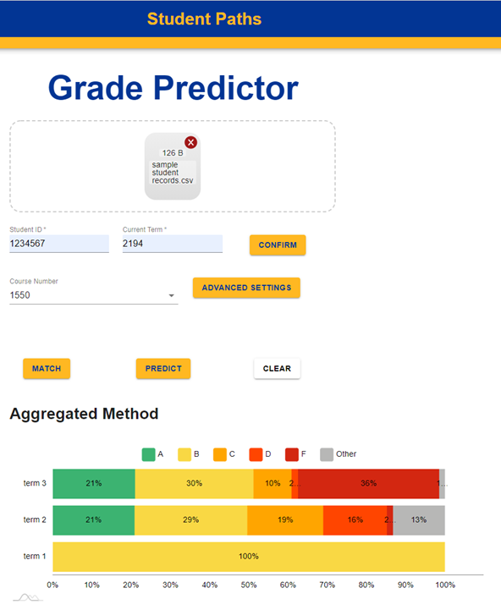
PRODUCT
Notes:
**Need a window to indicate recommendations
Provide a smaller example to prime people for the product: take only a small subsection of the CPMs and showcase it quickly to explain what students can derive from it and how they can choose to study as a result
Each curriculum has core concepts and we are showing them and their relationships visually

Slide 25
Solution
Assignments
Student
Instructor
BeyondTranscripts
Lectures
Notes:
We propose BeyondTranscripts, an AI based tool that collects information from those Homeworks and assignments throughout the semester to connect the dots and figure out what concepts students are struggling with, in order to advise everyone on the problems we are currently having and how it will affect the student’s performance in that course and beyond. What are the four stakeholders we are talking about? Students, advisors, faculty, and administrators.
No need to explain, just mention visual tools that help not just students but other educational stakeholders
Be clear about the idea proposal
Dont say HOW soltn works,
WHY is it a big idea!!!

Slide 26
Solution
Assignments
Student
Instructor
BeyondTranscripts
Lectures
Notes:
We propose BeyondTranscripts, an AI based tool that collects information from those Homeworks and assignments throughout the semester to connect the dots and figure out what concepts students are struggling with, in order to advise everyone on the problems we are currently having and how it will affect the student’s performance in that course and beyond. What are the four stakeholders we are talking about? Students, advisors, faculty, and administrators.
No need to explain, just mention visual tools that help not just students but other educational stakeholders
Be clear about the idea proposal
Dont say HOW soltn works,
WHY is it a big idea!!!

Slide 27
SOLUTION
A web-based toolset that analyzes student data to provide recommendations for student and instructor success
Instructors and Universities WIN:
Automatic Recommendations | Instructor Flexibility | Efficient Course Adaptation
Retain More Student Tuition | Lower Retention Costs
Students WIN:
Effective Instructor Advising | Personalized Assistance | Early Understanding
Successful Higher Education | Higher Average Salary

Slide 28
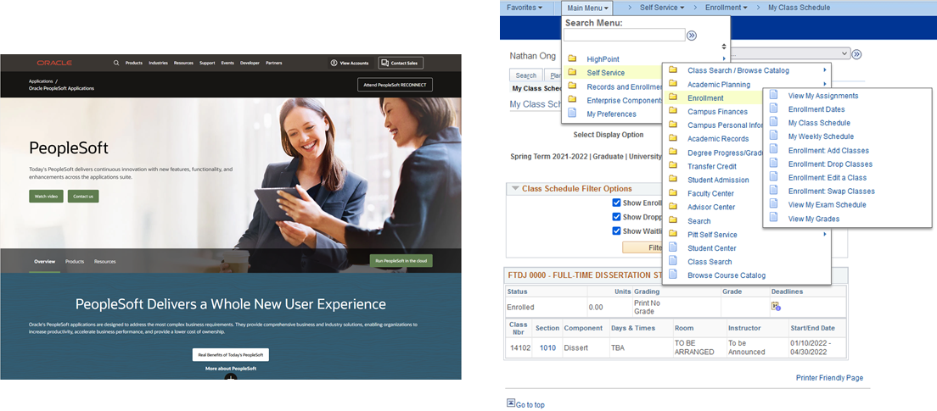
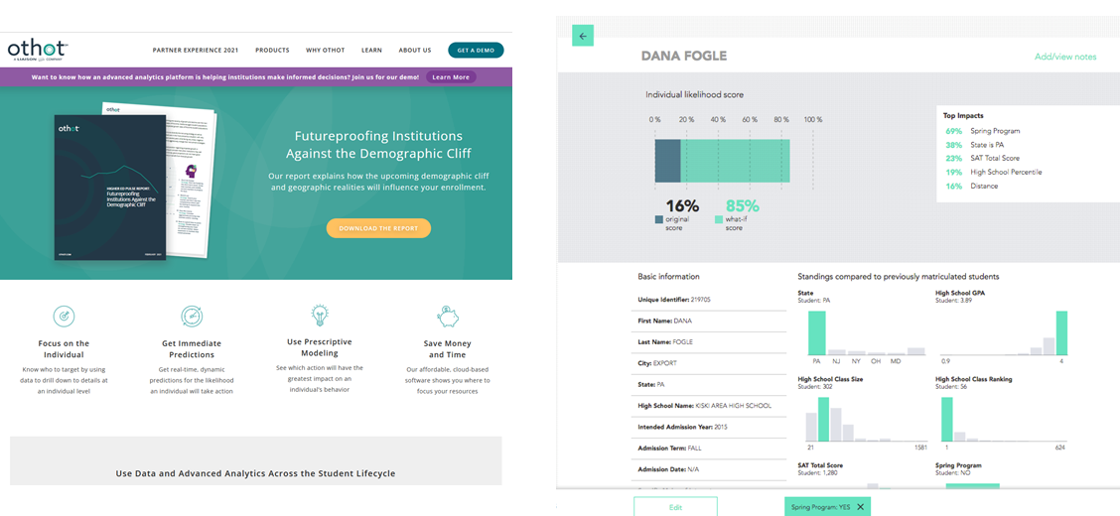
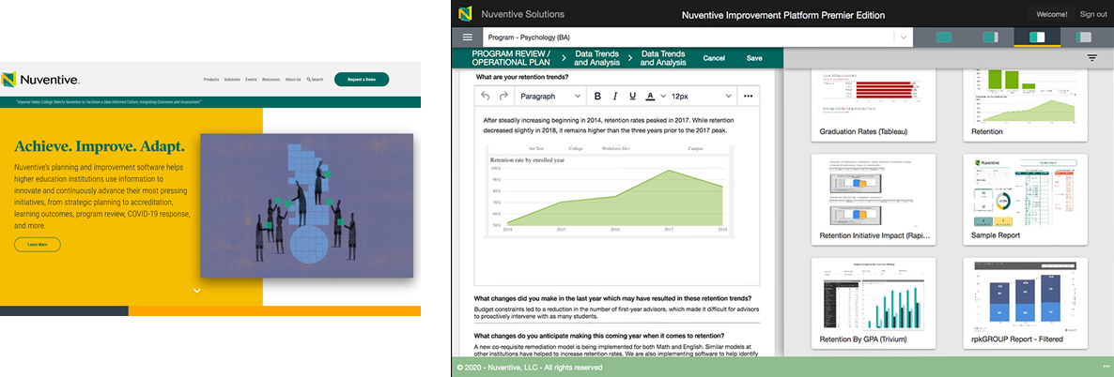
Competition
Graph of competitors on:
Data granularity (final grades only → per question performance)
Automatic Recommendation Level (no recommendations → full predictive system?)
Do more research on OTHOT
Notes:
PeopleSoft-
General purpose organization for large companies with lots of people
For Pitt, they use it generally for enrollment, scheduling, and official grade-keeping
OTHOT-Probability-based business metrics of success (i.e. enrollment, likelihood to pass, likelihood of retention, etc.) only for advisors, but given administrative metrics
Business oriented metrics for educational institutions (along with editing software to distribute insights to others) only for administrators
The success of BeyondTranscripts will provide a basis for an augmentable startup that supplies educational institutions with an all-inclusive service for analyzing their existing student data—(not collecting more data).
None of them are course-content oriented
https://www.pilbaragroup.com/
https://www.edulab.ai/

Slide 29
Business Model
Direct to universities
Why not per-student? It’s hard to prove with too few students, we need the data from all the students.
B2B access multiply efforts.
license at discount rate? $200K/year? 2.5% of the university tuition?
Discount at beginning (hooking clients)? After 3 months free, give quarterly analysis to blow them away
Standard list price, provide a multiplier depending on the institution depending on adding additional features

Slide 30
Significant
Recommendation Level
4 Box/4 Quadrant?
Market Players/Companies
BeyondTranscripts
Data Granularity
Coarse
Fine
Legend
Red - Targeted Enrollment Marketing
Orange - Academic Advising
Green - Academic Administration
Dark Blue - Direct to Student Software
Purple - Learning Management System
Light Blue - Course Content/Student Performance Analysis
None
Notes:
Red - targeted enrollment marketing for incoming students
Orange - Academic advising
Green - Academic Administration
Dark blue - Direct to student software
Purple - Learning Management System
Light blue - course content and student performance analysis
—-----
PeopleSoft-
General purpose organization for large companies with lots of people
For Pitt, they use it generally for enrollment, scheduling, and official grade-keeping
OTHOT-Probability-based business metrics of success (i.e. enrollment, likelihood to pass, likelihood of retention, etc.) only for advisors, but given administrative metrics
Business oriented metrics for educational institutions (along with editing software to distribute insights to others) only for administrators
The success of BeyondTranscripts will provide a basis for an augmentable startup that supplies educational institutions with an all-inclusive service for analyzing their existing student data—(not collecting more data).
None of them are course-content oriented

Slide 31
Compare to Peoplesoft
Notes:
General purpose organization for large companies with lots of people
For Pitt, they use it generally for enrollment, scheduling, and official grade-keeping

Slide 32
Compare to OTHOT
Notes:
Probability-based business metrics of success (i.e. enrollment, likelihood to pass, likelihood of retention, etc.) only for advisors, but given administrative metrics

Slide 33
Compare to Nuventive
Notes:
Business oriented metrics for educational institutions (along with editing software to distribute insights to others) only for administrators
The success of BeyondTranscripts will provide a basis for an augmentable startup that supplies educational institutions with an all-inclusive service for analyzing their existing student data—(not collecting more data).
None of them are course-content oriented

Slide 34
What we have accomplished over the Blitz Day 24 hours
Met with Entrepreneurs In Residence for advising of our initial startup pitch
Developed a pitch deck based on the feedback from our advisors
Added mock views of intended software solutions
Researched and developed a new personal story
Researched other competitors
Researched statistics pertaining to our problem, target customers, and market scope
Notes:
What we have done over the last 24 hours:
Met with entrepreneurial mentors for constructive feedback on our startup pitch
Developed a pitch deck based on feedback from our initial pitch
Modified our original pitch
Found other competitors
Found a personal story entirely different than our original

Slide 35
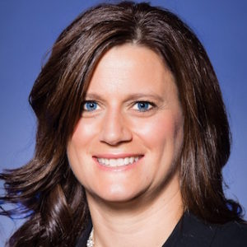


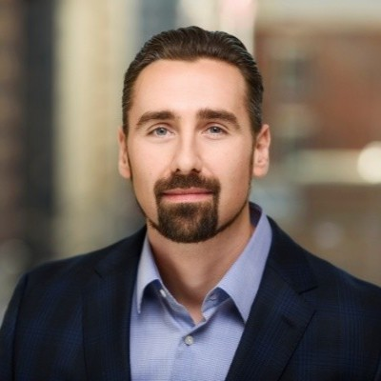
Entrepreneurs In Residence
A special thanks to those who have advised us:
Joanna Sutton Kelly Collier
Don Morrison Justin Frankert
Notes:
Need a better transition to the last sentence below
Transcripts no longer suffice; it’s time to go beyond transcripts.
What we have done over the last 24 hours:
Met with entrepreneurial mentors for constructive feedback on our startup pitch
Developed a pitch deck based on feedback from our initial pitch
Modified our original pitch
Found other competitors
Found a personal story entirely different than our original

